Slide 1


WEEK 1 · DAY 2
Key Terminology
The words you'll use every single day — each with a simple analogy.
Quality Thought · Gen AI Testing for Manual Testers
Quality Thought · Gen AI Testing · Week 1 · Day 2
1

Slide 2




TODAY'S SESSION
What we'll cover today
The core words
Tokens, context window, temperature
How it 'remembers'
Embeddings & vectors of meaning
The risk words
Hallucination, grounding, guardrails
The cost words
Latency and tokens = money
Quality Thought · Gen AI Testing · Week 1 · Day 2
2

Slide 3
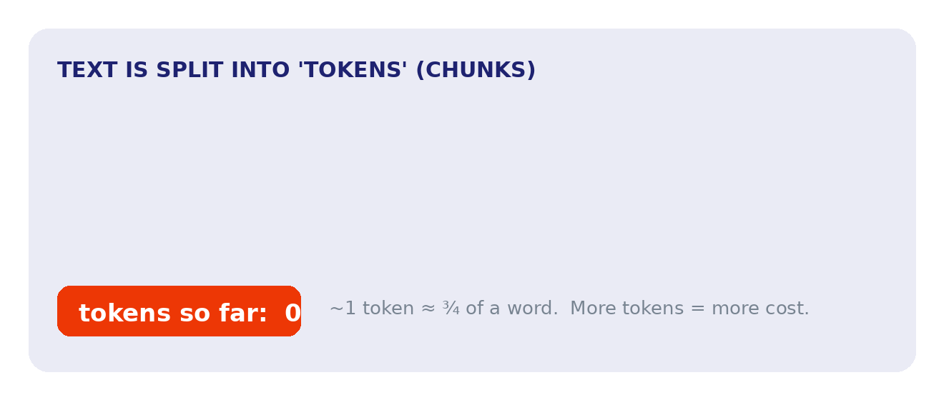
THE CORE WORD #1
Tokens — the LEGO bricks of text
What's a token?
Watch it work
Models don't read words — they read tokens: small chunks of text.
A token is roughly ¾ of a word.
Why testers care: tokens decide cost and the size limit of what fits in one request.
Animated — plays in slideshow mode
Quality Thought · Gen AI Testing · Week 1 · Day 2
3

Slide 4


THE CORE WORD #2
Context window — the whiteboard
The idea
What goes wrong
The context window is how much text the model can 'see' at once — its short-term memory.
Picture a whiteboard of fixed size.
When the whiteboard is full, older notes get wiped to make room.
Test for it: in long chats the model may 'forget' earlier facts.
Quality Thought · Gen AI Testing · Week 1 · Day 2
4

Slide 5


THE CORE WORD #3
Temperature — the creativity dial
Low temperature
High temperature
Predictable, focused, repeatable.
Best for facts — and for our regression tests (set it to 0).
Creative, varied, surprising.
Great for brainstorming — but flakier, so answers vary more.
Quality Thought · Gen AI Testing · Week 1 · Day 2
5

Slide 6

THE CORE WORD #4
Embeddings — GPS for meaning
The idea
Why it matters
An embedding turns text into numbers (a 'vector') that capture its meaning.
Like giving every sentence GPS coordinates.
Similar meanings sit close together on the map.
This is how search and RAG 'find' the right information later.
Quality Thought · Gen AI Testing · Week 1 · Day 2
6

Slide 7



THE REST OF THE GLOSSARY
Five more words you'll hear daily
Hallucination
Grounding
Guardrail
A confident but made-up / false answer
Answering using real, provided sources
A safety rule that blocks bad output
Latency
Token cost
System vs user prompt
How long the answer takes to come back
More tokens = more money per request
Hidden rules vs the user's actual question
Quality Thought · Gen AI Testing · Week 1 · Day 2
7

Slide 8

LESSON OUTCOMES
What you can now do
Explain tokens, context window and temperature in plain words
Describe what embeddings do and why they matter for search
Define hallucination, grounding and guardrails
Explain how tokens relate to cost and request limits
Quality Thought · Gen AI Testing · Week 1 · Day 2
8

Slide 9

QUICK CHECK
Check your understanding
Q1.
About how much of a word is one token?
Q2.
For repeatable regression tests, set temperature to... low or high?
Q3.
What does the context window limit?
Q4.
What word describes a confident but made-up answer?
Quality Thought · Gen AI Testing · Week 1 · Day 2
9

Slide 10
QUICK CHECK
Answers
A1.
Roughly three-quarters (¾) of a word.
A2.
Low (set it to 0) — so output is consistent and repeatable.
A3.
How much text the model can 'see' at once (its short-term memory).
A4.
Hallucination.
Quality Thought · Gen AI Testing · Week 1 · Day 2
10

Slide 11


BEFORE NEXT SESSION
Your 30-minute lab + what's next
Today's mini-lab (30 min)
Coming up next
Open a tokenizer playground (e.g. an online token counter).
Paste 5 sentences and note the token count of each.
Try a long paragraph — see how the count grows.
Write 2 lines: how would token count affect cost & limits?
Save notes in your GitHub: week1/day2-notes.md
Day 3 — Why Traditional QA Breaks
Non-determinism and the 'oracle problem': why the same question gives different answers, and what we check instead.
Quality Thought · Gen AI Testing · Week 1 · Day 2
11

